Slide 1
Firefighter Robot Car
An autonomous firefighting robot car with ESP32 Microcontroller
CSE-3116: Microcontroller Lab
Mehedi Hasan (22)
Farhana Alam (48)

Slide 2

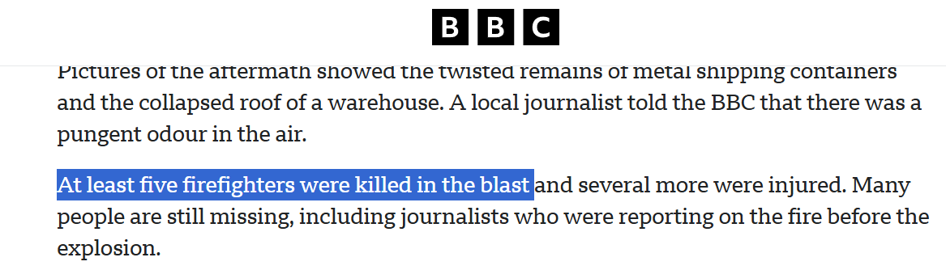

Why Firefighter Robot Car??
Bangladesh has witnessed tragic losses of firefighters in rescue operations. This robot car offers a safer alternative by autonomously detecting and extinguishing fires before human intervention is required.

Slide 3
What we made?
A smart robot that automatically finds and fights fires using flame sensors and a water pump system. Features WiFi control for remote operation and manual override when needed.
GitHub Link: Project

Slide 4
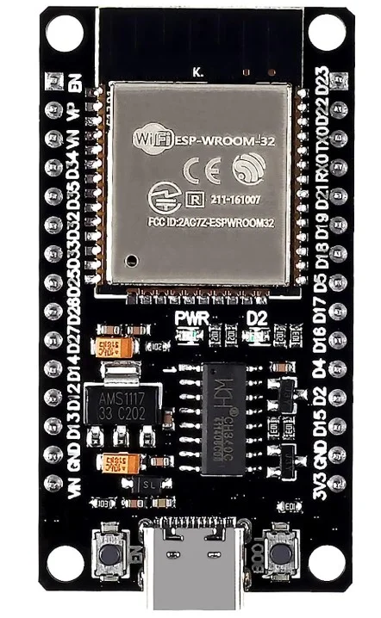
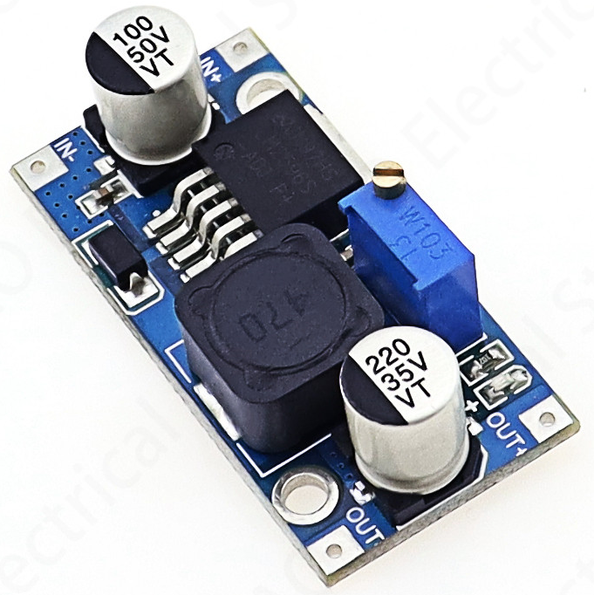
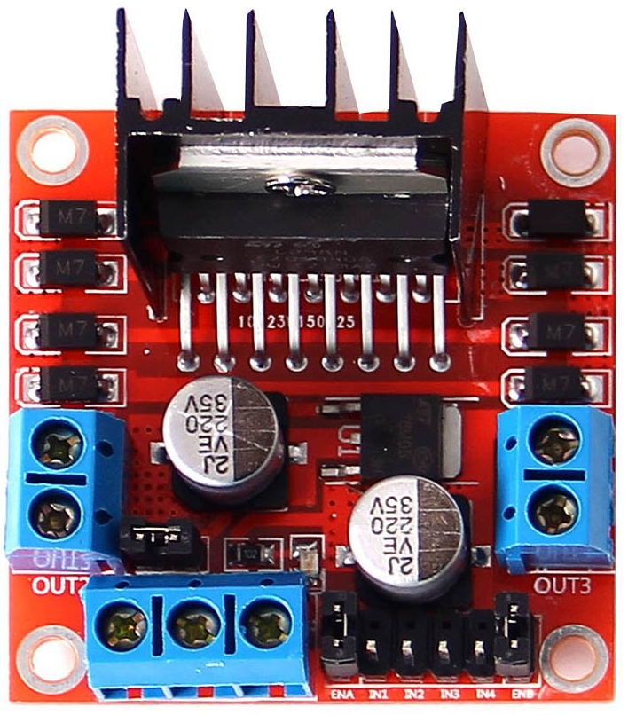
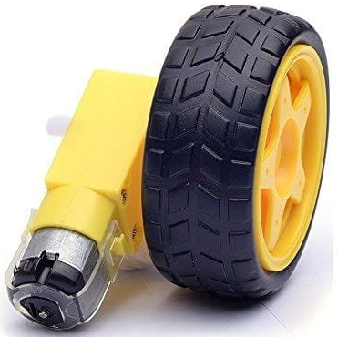
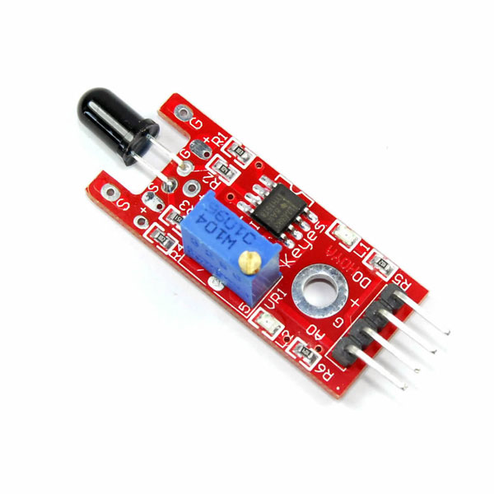
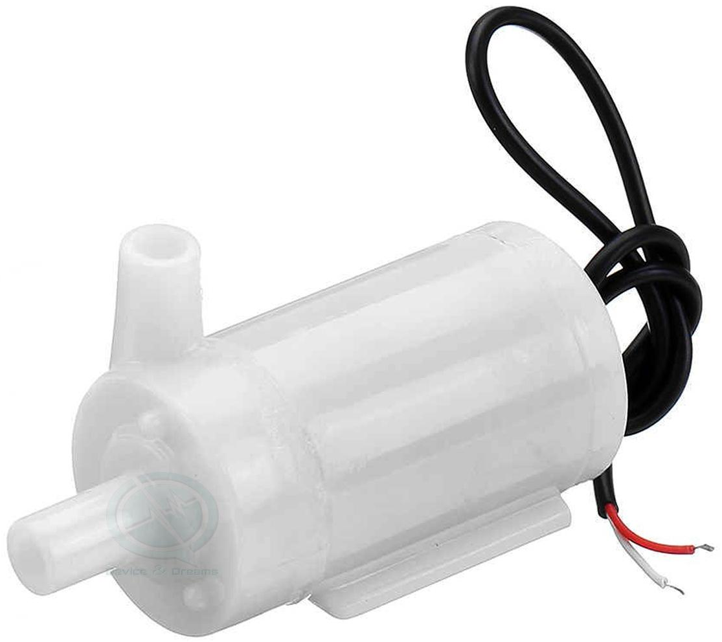
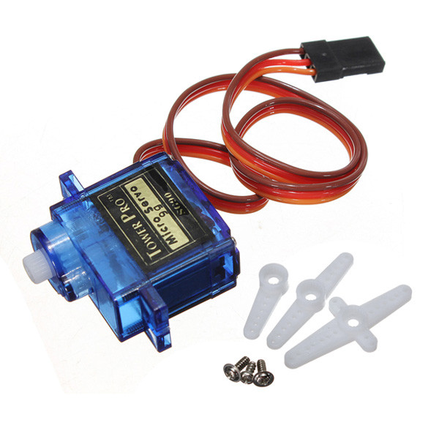
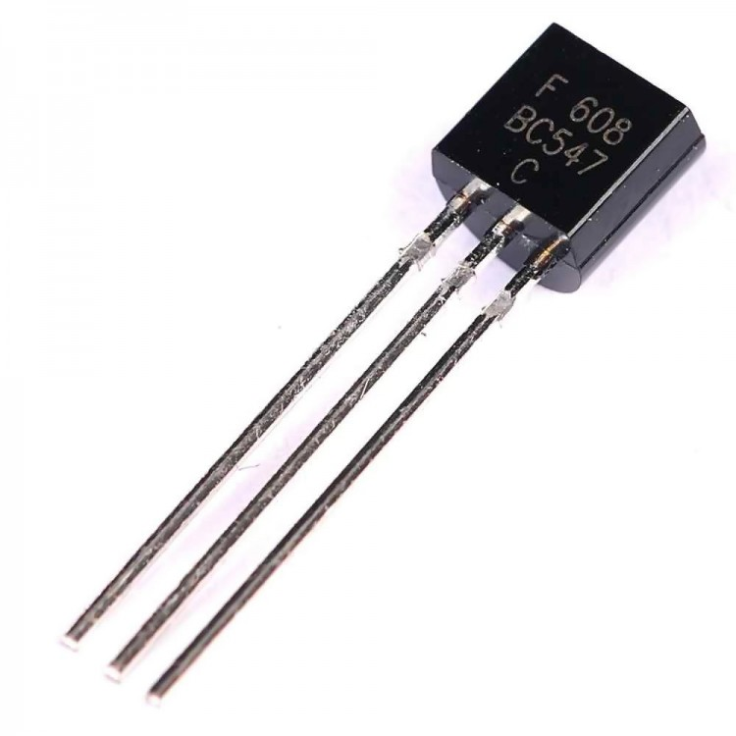

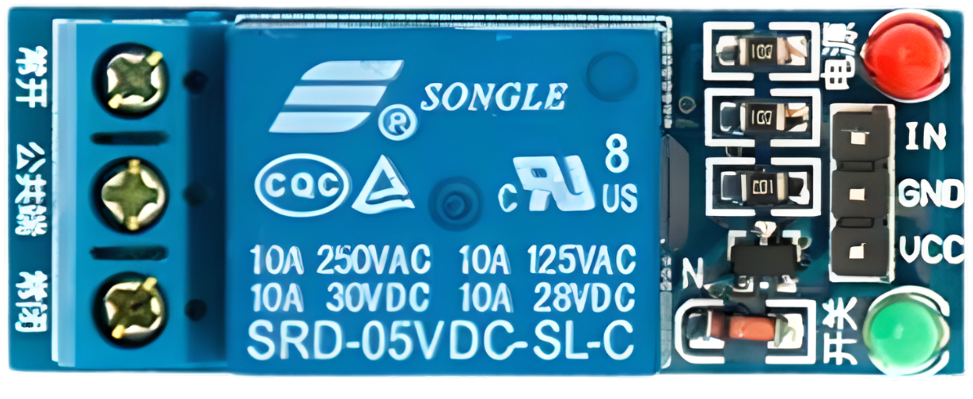
Components we used
ESP32 Microcontroller
L298N Motor Driver
4 x Gear Motor with wheel
3 x Flame sensor
LM2596 Buck Converter
5V Relay (Single Channel)
Mini Water Pump
BC547 NPN Transistor
Servo Motor
Plywood
Also Some Wires, breadboard, a 1kΩ resistor, switch, water tube etc.

Slide 5
How it works?
5V
L
M
R
GND
GPIO Pin
We used analog pin to detect signal. Because they offers more detail by providing varying voltage (intensity/distance), which is better for precise fire detection
Left Flame Sensor (AO) — GPIO 34
Middle Flame Sensor (AO) — GPIO 35
Right Flame Sensor (AO) — GPIO 32

Slide 6
We used 2 Gear motor parallely in each side of motor driver to make it a 4 wheeler car.
ENA
IN1
IN2
ENB
IN4
Motor (+ve)
Motor (-ve)
Motor (+ve)
Motor (-ve)
IN3
ENB — GPIO 14
IN4 — GPIO 13
IN3 — GPIO 18
IN2 — GPIO 27
IN1 — GPIO 26
ENA — GPIO 25
Common GND
+12V Source
+5V Source
Gear Motor + Wheel

Slide 7
Uses of all pins in L298N Motor Driver:
L298N Pin | ESP32 Pin | Description
ENA | GPIO 25 | Left Motor Speed (PWM)
IN1 | GPIO 26 | Left Motor Direction 1
IN2 | GPIO 27 | Left Motor Direction 2
IN3 | GPIO 18 | RIght Motor Direction 1
IN4 | GPIO 13 | Right Motor Direction 2
ENB | GPIO 14 | Right Motor Speed (PWM)

Slide 8
Why Buck Converter Was Needed and how it works?
Robot battery provides 12V but ESP32 operates safely at 5V (via Vin) or 3.3V
Direct 12V → ESP32 ❌ will damage the board
Buck converter
Takes 12V input
Efficiently steps down to 5V
Why Buck Converter?
High efficiency
Less heat
Stable voltage for ESP32
LM2596 Buck Converter

Slide 9
Water Pump Control System
Components Used:
Mini Water Pump (12V)
Relay Module
BC547 NPN Transistor
1KΩ Resistor
External 12V supply
Purpose:
ESP32 controls high-power pump safely
BC547 Collector
Common GND
+5V Source
Pump +VCC
+12V Source
Mini Water Pump
BC547 NPN Transistor

Slide 10
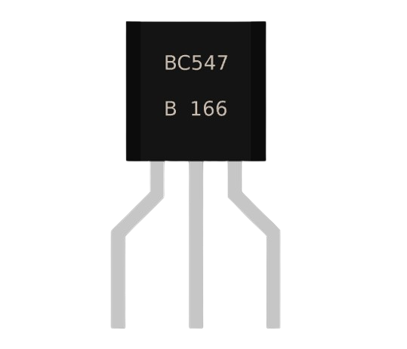
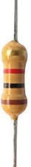
BC547 to Others
ESP32 to Transistor Connection-
ESP32 GPIO 23 → 1kΩ Resistor → BC547 Base (Middle pin)
BC547 Emitter (Left pin) → GND
BC547 Collector (Right pin) → Relay IN pin
Relay Module Connection-
VCC → 5V
GND → Common GND
IN → BC547 Collector
COM → Pump VCC (+)
NO (Normally Open) → Battery / External Power Supply (+)
E
B
C
1kΩ
GND
+5V

Slide 11
Role of Transistor, Resistor, Relay Module
BC547 Transistor-
Acts as a switch
Amplifies ESP32 low current signal
Protects ESP32 GPIO
Relay Module-
ESP32 GPIO → 3.3V low current
Pump requires 12V high current
Relay provides:
Electrical isolation
Safe switching
1KΩ Resistor-
Limits base current
Prevents transistor damage
ESP32 → Transistor → Relay → Pump

Slide 12
Why Servo Motor Was Used
Servo motor provides:
Precise angle control
Stable positioning
Used to:
Aim the water nozzle
Rotate towards the fire direction
Servo Wiring:
Servo Signal (Yellow/Orange) → ESP32 PWM GPIO pin 33
Servo VCC (Red) → 5V supply
Servo GND (Brown/Black) → Common GND

Slide 13
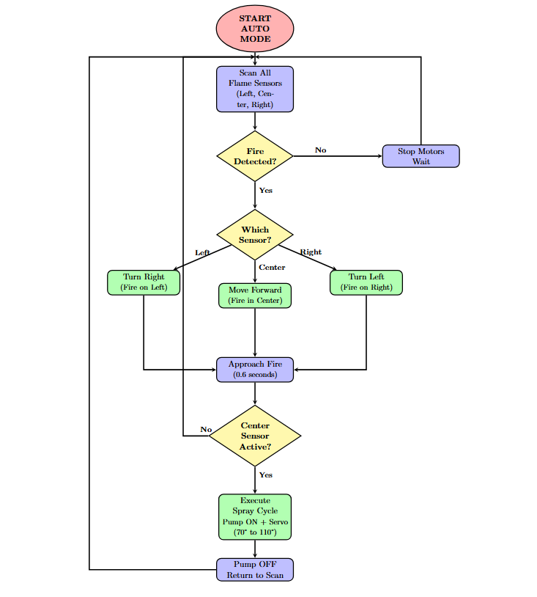
Working Procedure & Flow Diagram
Buck converter supplies 5V to ESP32
Sensors feed analog data to ESP32
ESP32 logic:
Detect fire
Rotate servo
Activate pump
Common GND shared across system
Robot successfully:
Detects fire direction
Moves toward flame
Aims nozzle
Pumps water automatically

Slide 14
Challenges Faced
Battery voltage drop when pump and motors run together
Noise in analog sensor readings
Sensor value fluctuation due to heat and light
Servo jitter because of sudden current draw
Wrong threshold value caused false detection
Multiple sensors conflict confused fire direction
Servo aiming delay needed for accurate targeting
Pump timing issue (too short / too long)
Action sequencing problem (move, aim, then pump)

Slide 15
Conclusion
We successfully designed and implemented a Firefighter Robot Car using ESP32
The buck converter safely stepped down 12V to 5V, ensuring stable power for ESP32
Flame sensors enabled early fire detection using analog signals
The servo motor allowed accurate aiming of the water nozzle
Relay and transistor circuitry made it possible to control a high-power water pump safely
Hardware and logic challenges were overcome through proper grounding, sequencing, and threshold tuning
The system demonstrates a safe, low-cost, and effective solution for reducing human risk in fire emergencies

Slide 16
Future Improvements
Add camera + AI fire detection
Use thermal sensor
Increase water pressure
Add GSM & Wifi alert system
Industrial-grade chassis
Thank You

